Slide 1
Signature Classification using Custom CNN
Team:
Noel Flores
Chinwe Aghadinuno

Slide 2
DEFINE TASK
The primary task is Signature Recognition/Classification through the use of Siamese Neural Networks.
Goal:
Given two signature images - the goal is to determine if they belong to the same individual (genuine) or are forgeries. This method is especially useful for fraud detection in banking.
Create Custom CNN and compare the results against the Inception-v1 and Inception-v3 that were employed.

Slide 3
FRAMEWORK AND LIBRARIES
Framework:
PyTorch or TensorFlow/Keras to build and train Siamese networks
Libraries:
NumPy - Efficient matrix and vector operations
Pandas - Organize image pair metadata and labels
Matplotlib - Plot training curves, signature samples
Scikit-learn - Evaluate accuracy, precision

Slide 4
UPDATED BLOCK DIAGRAM
Signature A
Create our own CNN
Feature Vector A
Genuine = 1
Shared CNN
Contrastive Loss Function
Compare
Both CNN accuracies
Shared CNN
Forged = 0
Signature B
Create our own CNN
Feature Vector B

Slide 5
POTENTIAL CHALLENGES
Signature Variation:
Even genuine signatures can vary from the same person depending on pressure, speed which can result in a mistaken classification of forgery.
Skilled Forgeries:
Some forgeries are visually very close to genuine signatures especially if it's done by a professional.
Threshold Tuning for Similarity
With Siamese Network, determining the threshold of similarity will be difficult and require careful tuning.

Slide 6
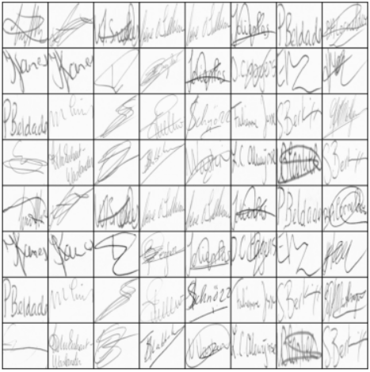
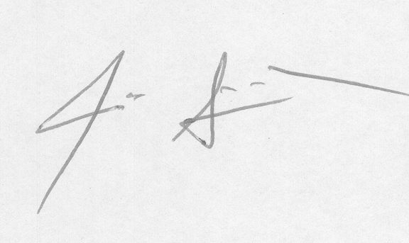
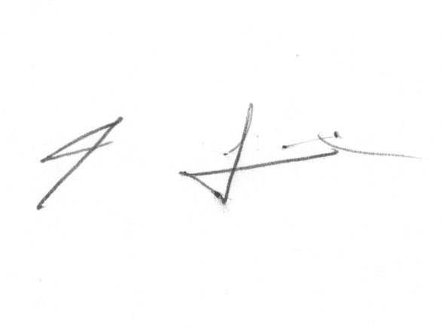
PRE-TRAINED MODEL
Original
Forged
This dataset contains two folders:
Train Dataset: 1700 images
Test Dataset: 500 images
MODEL PARAMETERS:
Batch size: 32
Epoch: 20
Preprocessed into signature pairs for Siamese learning.
Convolution Neural Network Layers.
RELU Activation Function.

Slide 7
PROJECT UPDATE/DATA PREPROCESSING
Key Limitations with Shared Model | Modifications/Updates Performed
Labels(“original” or “forged”) were assigned based on a csv file names, instead of the prediction by the model. | Integrated data labeling to compute predicted labels based on the model dissimilarity values.
No Classification or prediction was performed. | Included true labels (actual labels) to assess the model’s predictions, enabling correctness verification.
Accuracy or performance evaluation was not performed | Updated codes enable performance evaluation of the model

Slide 8
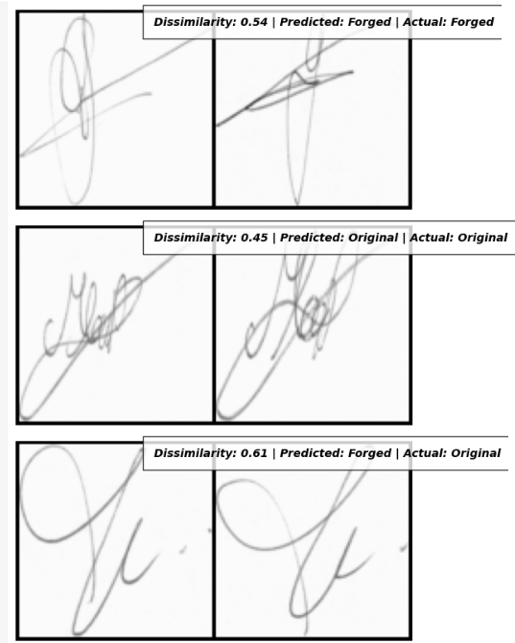
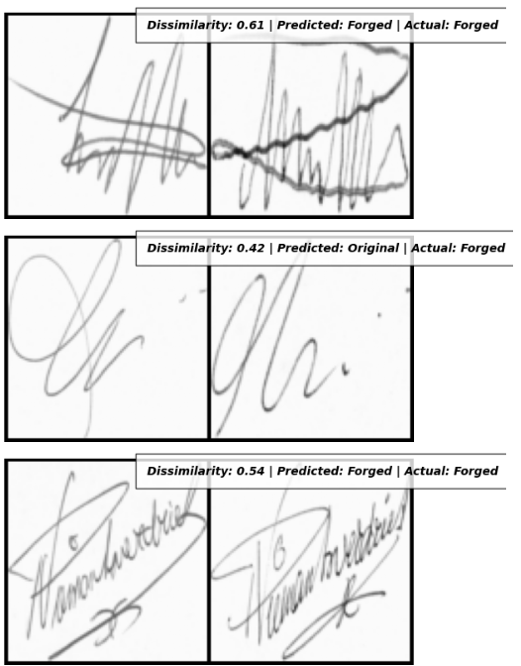
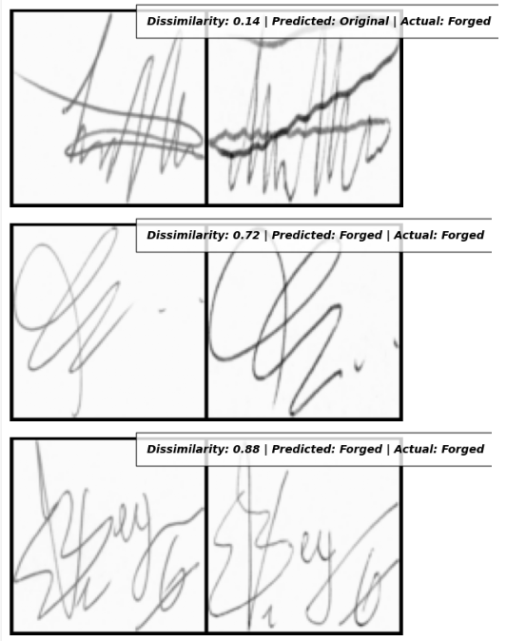
DISPLAY OF PRE-TRAINED MODEL PREDITION

Slide 9
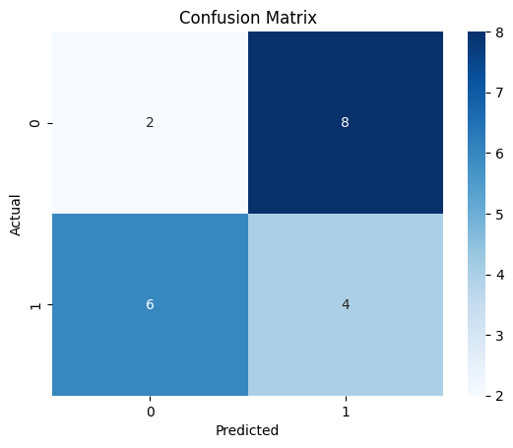
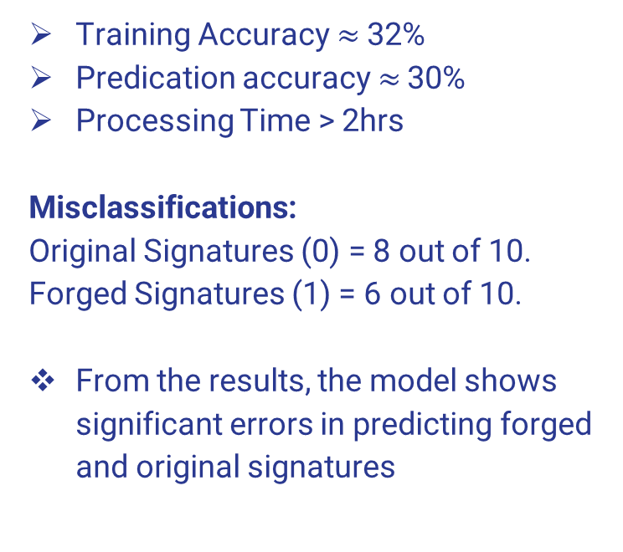
RESULTS FOR THE PRETRAINED MODEL
Training Accuracy $≈$32%
Predication accuracy $≈$ 30%
Processing Time > 2hrs
Misclassifications:
Original Signatures (0) = 8 out of 10.
Forged Signatures (1) = 6 out of 10.
From the results, the model shows significant errors in predicting forged and original signatures

Slide 10
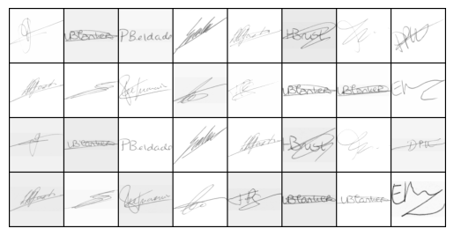
CREATED MODEL
This dataset contains two folders:
Train Dataset: 1700 images
Test Dataset: 500 images
MODEL PARAMETERS:
Batch size: 16 (reduced the batch size)
Epoch: 40 (increased the numer of epochs)
Custom model with like structure as the Residual Neural Network Architecture.
RELU Activation Function.
Pairwise distance is used to compute the Euclidean distance or threshold between each pair of vectors (actual and predicted) to determine dissimilarity levels
Original
Forged

Slide 11
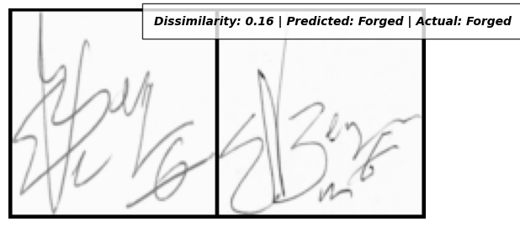
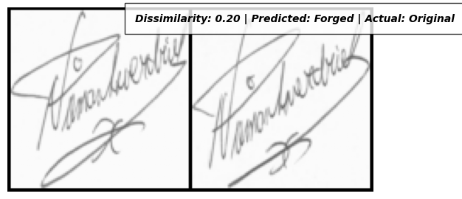
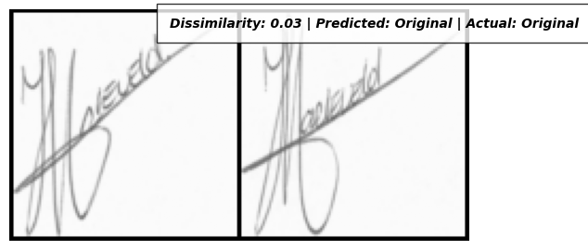
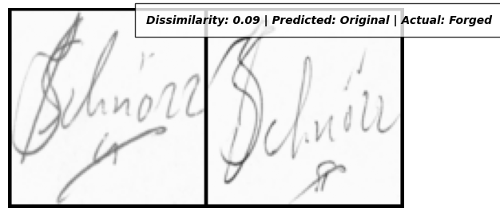
DISPLAY OF CREATED MODEL PREDITIONS
TN – TRUE NEGATIVE
FN – FALSE NEGATIVE
TP – TRUE POSITIVE
FP – FALSE POSITIVE

Slide 12
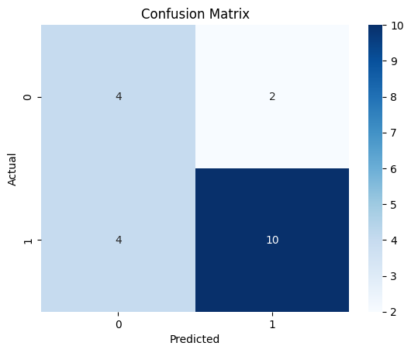
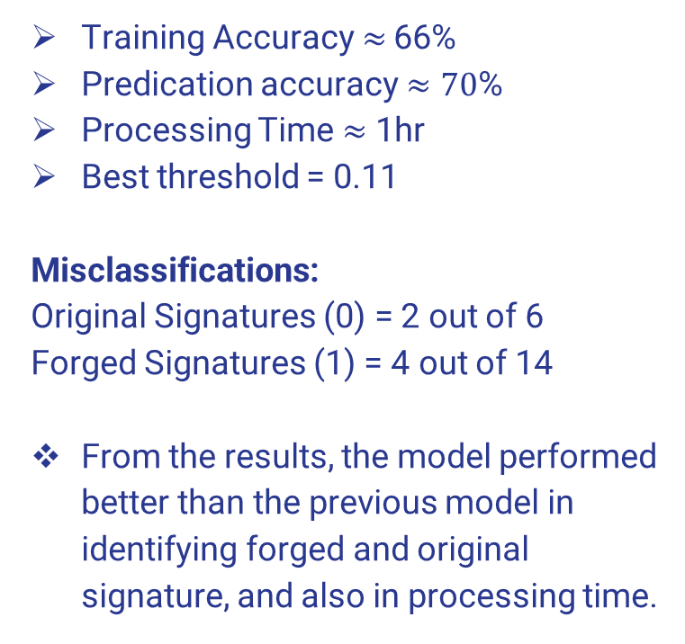
RESULTS FOR THE CREATED MODEL
Training Accuracy $≈$ 66%
Predication accuracy $≈70$%
Processing Time $≈$ 1hr
Best threshold = 0.11
Misclassifications:
Original Signatures (0) = 2 out of 6
Forged Signatures (1) = 4 out of 14
From the results, the model performed better than the previous model in identifying forged and original signature, and also in processing time.

Slide 13
SOME TAKEAWAYS.
Learnt how Siamese Network work and its implementation.
Created a model that gave a better performance accuracy and in a shorter processing time.
Learnt how to integrate prediction analysis in image processing.
The importance of hyperparameters and threshold tuning, and how they can contribute to the model overall performance.
Experienced how important hardware capability is, and the limitations of CPU when training deep learning models.

Slide 14
Sources
Signature Classification Using Siamese (PyTorch)
ICDAR 2011 Signature Dataset
https://pytorch.org/docs/stable/index.html
https://keras.io/examples/vision/siamese_network/
Siamese Convolutional Neural Network-Based Twin Structure Model for Independent Offline Signature Verification

